Slide 2
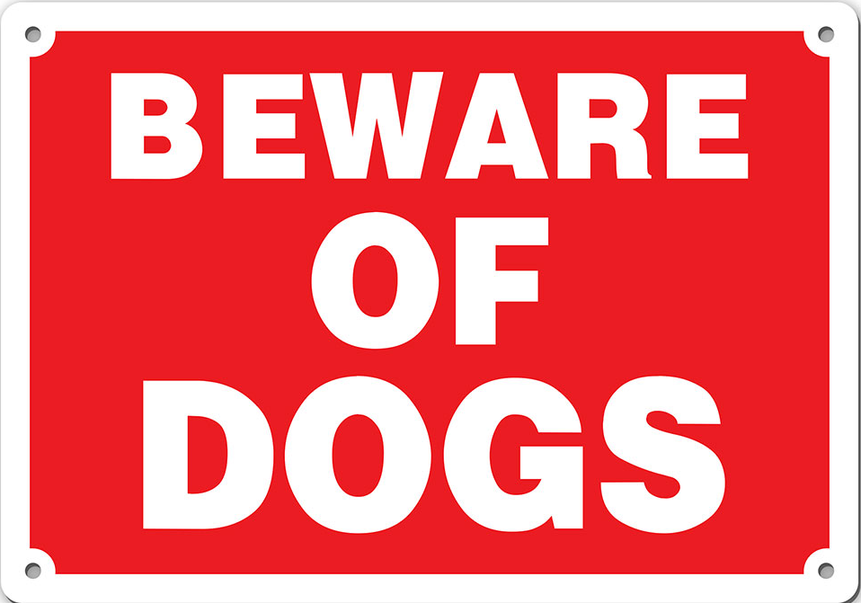
Philippians 3:1-3
Presenter Name
Notes:
ID=d924773e-9a16-4d6d-9803-8cb819e99682
Recipe=text_billboard
Type=TextOnly
Variant=0
FamilyID=AccentBoxWalbaum_Zero

Slide 3
What Does Paul Mean?
DOG in the Bible is often used to describe that which is low, base, despised or morally evil
1 Samuel 24:14 “Whom do you pursue? A dead dog? A flea?"
Luke 16:21 “the dogs came and licked his sores.”
Deuteronomy 23:18 “price of a dog” or “wages of a dog”

Slide 4
What Does Paul Mean?
Evil Workers of the “concision” (KJV) or “mutilation” (NKJV) or “false circumcision” (NASV)
“You think you are Jews, but you are only mutilated!”
Mutilation was forbidden under the Law of Moses- Leviticus 21:5 “nor make any cuttings in their flesh.”

Slide 5
INCONSISTENCY
Peter found guilty – Galatians 2:11-21
Paul rebuked him in front of everyone!
Some Jews came in under cover to spy out their liberty in Christ!
Galatians 2:14 “they were not straightforward about the truth of the gospel”

Slide 6
INCONSISTENCY
Galatians 5:3,4 “you who {attempt to} be justified by law; you have fallen from grace."
Galatians 1:6 - They were following a PERVERTED GOSPEL!
The cursing, social drinking, semi-faithful of the church, does more harm to the cause of Christ through INCONSISTENCY than any outsider could EVER DO!

Slide 7
BLATANT DISREGARD FOR DIVINE AUTHORITY
Dogs of Paul’s day BOUND CIRCUMCISION – Acts 15:1
John 7:22 “not that it is from Moses, but from the fathers”
They were still loyal to the LAW!
It was actually a question of AUTHORITY!

Slide 8
BAD MOTIVES
Dogs of Paul’s day wanted to make a “fair show in the flesh”
Galatians 4:17 "They zealously court you, {but} for no good; yes, they want to exclude you, that you may be zealous for them."
2 Peter 2:19 “"While they promise them liberty, they themselves are slaves of corruption”
Galatians 5:20 ““dissensions, heresies...will not inherit the kingdom of God.”

Slide 9
WHY SHOULD WE BEWARE OF DOGS?
TRUTH IS PRECIOUS!
ERROR IS REAL THREAT TO OUR SOULS!
CHURCH OF OUR LORD IS THE MOST PRECIOUS BODY ON EARTH!
WE MUST BEWARE OF ANYTHING OR ANYONE WHO WOULD POSE A THREAT TO THAT BODY!
BEWARE OF DOGS!

